Slide 1

WNE UW
Applied microeconomics – experimental and computational approach
Risk , uncertainty, randomness
INTRO
Notes:
1

Slide 2
Risk , uncertainty, randomness
We are living in a very uncertain world. For us, the problem how to deal with uncertainty is the most important economic issue of our time.
Economists, instead to try to understand the problem widely, are so convicted that they found the tools to avoid the risk that ….. they create more uncertainty.

Slide 3
Risk , uncertainty, randomness
Examples:
Just before the last crisis (2008), Alan Greenspan, Chairman of the Federal Reserve of the United States, said:
…. complex financial instruments have contributed to the development of a far more flexible, efficient, and hence resilient financial system than the one that existed just a quarter-century ago (Greenspan 2005).
But …..

Slide 4
Risk , uncertainty, randomness
…. he should …. consider the fate of Long-Term Capital Management, a hedge fund set up by, among others, the economists Myron Scholes and Robert Merton in 1994. With their work on derivatives, Scholes and Merton seemed to have hit on a formula that yielded a safe but lucrative trading strategy. In 1997 they were awarded the Nobel prize. A year later, Long-Term Capital Management lost $4.6bn (£3bn)in less than four months; a bailout was required to avert the threat to the global financial system. Markets, it seemed, didn’t always behave like scientific models.
https://www.theguardian.com/commentisfree/2015/oct/11/nobel-prize-economics-not-science-hubris-disaster

Slide 5
Risk , uncertainty, randomness
but … Myron Scholes and Robert Merton should remember the story of Irving Fisher the father of the modern investment theory who is remembered .... for the worst stock market call in history. Just before the Great Depression, he declared that stocks had reached a “permanently high plateau”. ….
The main problem is that we (economist) believe that we can deal with uncertainty. But we can deal only with the risk. We mix the model with the reality - it is the definition problem.

Slide 6
Risk , uncertainty, randomness
Our world is uncertain in different ways. We do not know the lotteries we play. We only guess the probability of the events and values of the losses and prizes. Behavioural economics try to find how we deal with the situation. But in finance and investment, we use a model of risk in which:
(discrete version) We know finite numbers of known events and probabilities of their appearance. We know the values of outcomes of the lottery.
(continuous version) We know the distribution of outcomes
The modern finance is based on the assumption that we live in the TV show Let’s Make a Deal. (https://www.youtube.com/watch?v=T5QYTrDReTo)

Slide 7
Risk , uncertainty, randomness
When we can evaluate the lottery(risk) we can treat risk as a "tradable good". We can sell and buy risk. The more a person is risk averse the more money he/she pays for reduction of the risk.
But the idea that risk trading will efficiently reduce uncertainty was wrong. The trade was like the hot potato game. The player who is holding the risk when the illusion ends will be eliminated from the play.

Slide 8
Risk , uncertainty, randomness
In our microscale [Know thyself], you should know that some institutions play with us and are using our cognitive biases. They are using our perception of probability/risk and our attitude towards risk to achieve their goals.
- insurance companies try to increase our risk aversion --> we will pay more for insurance.
- investment companies try to increase our risk tolerance --> we will receive less income for the risk taken.
- politicians and terrorists like management by fear
- add your example .............. teachers like management by fear too :)

Slide 9
Risk , uncertainty, randomness
My storyteing which I would like to tell you is Gerd Gigerenzer’s idea:
In an uncertain world, it is impossible to determine the optimal course of action by calculating the exact risks. We have to deal with "unknown unknowns." Surprises happen. Even when calculation does not provide a clear answer, however, we have to make decisions ….. When making decisions, the two sets of mental tools are required:
RISK: If risks are known, good decisions require logic and statistical thinking.
UNCERTAINTY: If some risks are unknown, good decisions also require intuition and smart rules of thumb.
Most of the time, a combination of both is needed. Some things can be calculated, others not, and what can be calculated is often only a crude estimate.

Slide 10
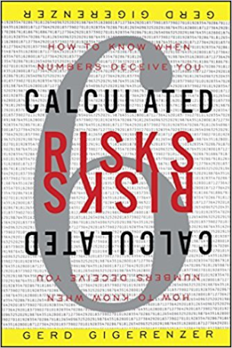
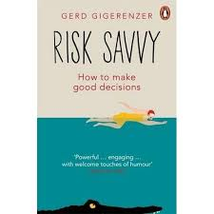
Logic and statistical thinking
Do not worry. You are in a better situation then ordinary people. You only need to combine your statistical knowledge with applications of everyday life. I recommend you one of the books:
and an old Kahneman and Tversky article (file: Kahneman-Tversky-1972.pdf) showing how researchers have problems to understand statistical problems.

Slide 11
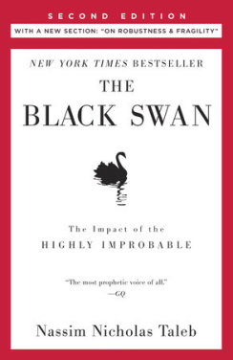
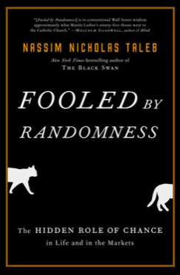
Risk , uncertainty, randomness
In macroscacle (finacial markets) Please !!! read one of the Nassim Nicholas Taleb’s series of books, in which he showed the problem of risk and ucertentity in our time. I recomend you two moust influential books:
And you should know the concept of fundamental uncertainty which was introduced in economics by Keynes (1921) and Knight (1921). They stressed that we should make a distinction between risk and uncertainty. And you should not assume that the economic processes are ergodic. There is path dependence. (Experiment 4)

Slide 12
Risk , uncertainty, randomness
To achieve the goals, I divided the lecture into four parts:
Microeconomic theory vs experimental results: i) how can we play with your perception of probability and risk, ii) are you really a risk-averse person?
How we deal with time and risk; My feeling: a new approach, non-ergodic revolution is coming.
How to deal with risk and [uncertainty] Monte Carlo simulation, Value at Risk, different measures of risk entropy / Bootstrap / Markov Chains, Models, and their applications.
System Dynamics and Agent-based Computational Economics Between Deterministic Chaos and Real Modelling of Uncertainty.

